Slide 1
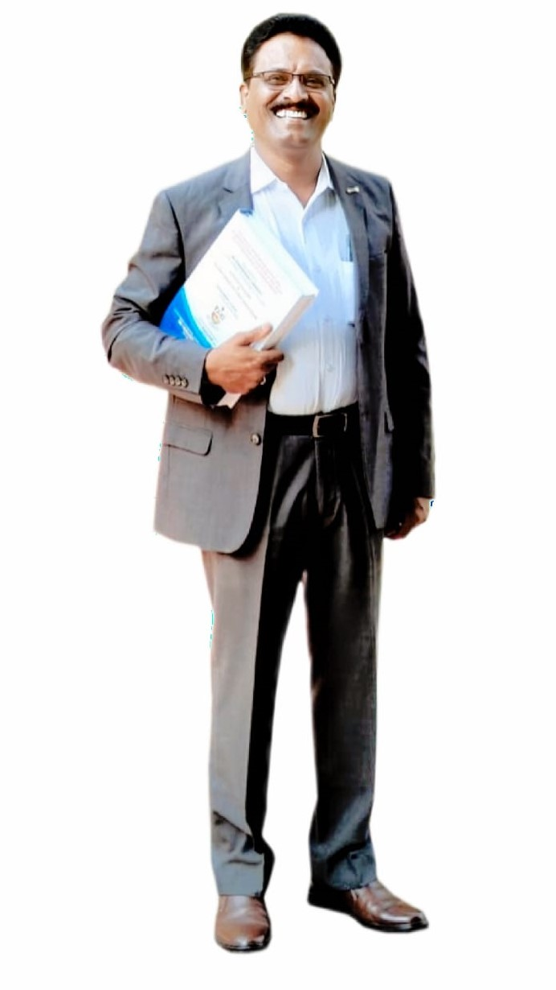
Dr K S KANNAN
M.A.,M.A.,M.A.,M.Ed., PGDCA, Ph.D.,
School Assistant in Social Studies
ZPHS(B), V KOTA
CHITTOOR DISTRICT
Andhra Pradesh, INDIA

Slide 2

Gender, Religion and Caste
Understanding Social Divisions in India
In India, society is a rich tapestry woven with diverse threads of gender, religion, and caste. While these aspects contribute to the country's vibrant cultural heritage, they have also historically been sources of significant social divisions and inequalities. This presentation aims to explore how these divisions manifest, their impact on the lives of individuals, particularly young students, and the ongoing efforts to foster a more equitable and inclusive society.

Slide 3

Understanding Gender Division in Society
Gender division, often mistakenly attributed to biological differences, is fundamentally a social construct. It refers to the societal expectations and roles assigned to individuals based on their perceived gender, often leading to stereotypes that limit potential.
Historically, there has been a prevalent "sexual division of labour". This pattern dictates that women are primarily responsible for domestic chores, child-rearing, and caregiving within the home, while men are expected to be the primary breadwinners, working outside the household. This division not only confines women to specific roles but also often undervalues their immense contribution to the family and economy, as their work is largely unpaid and unrecognised.
This division has profound implications, shaping educational opportunities, career choices, and overall life trajectories for both boys and girls. Breaking free from these rigid expectations is crucial for achieving true gender equality.
The challenge lies in recognising that these roles are learned, not inherent, and can be changed to promote a more balanced and just society where individuals are free to pursue their aspirations regardless of gender.

Slide 4
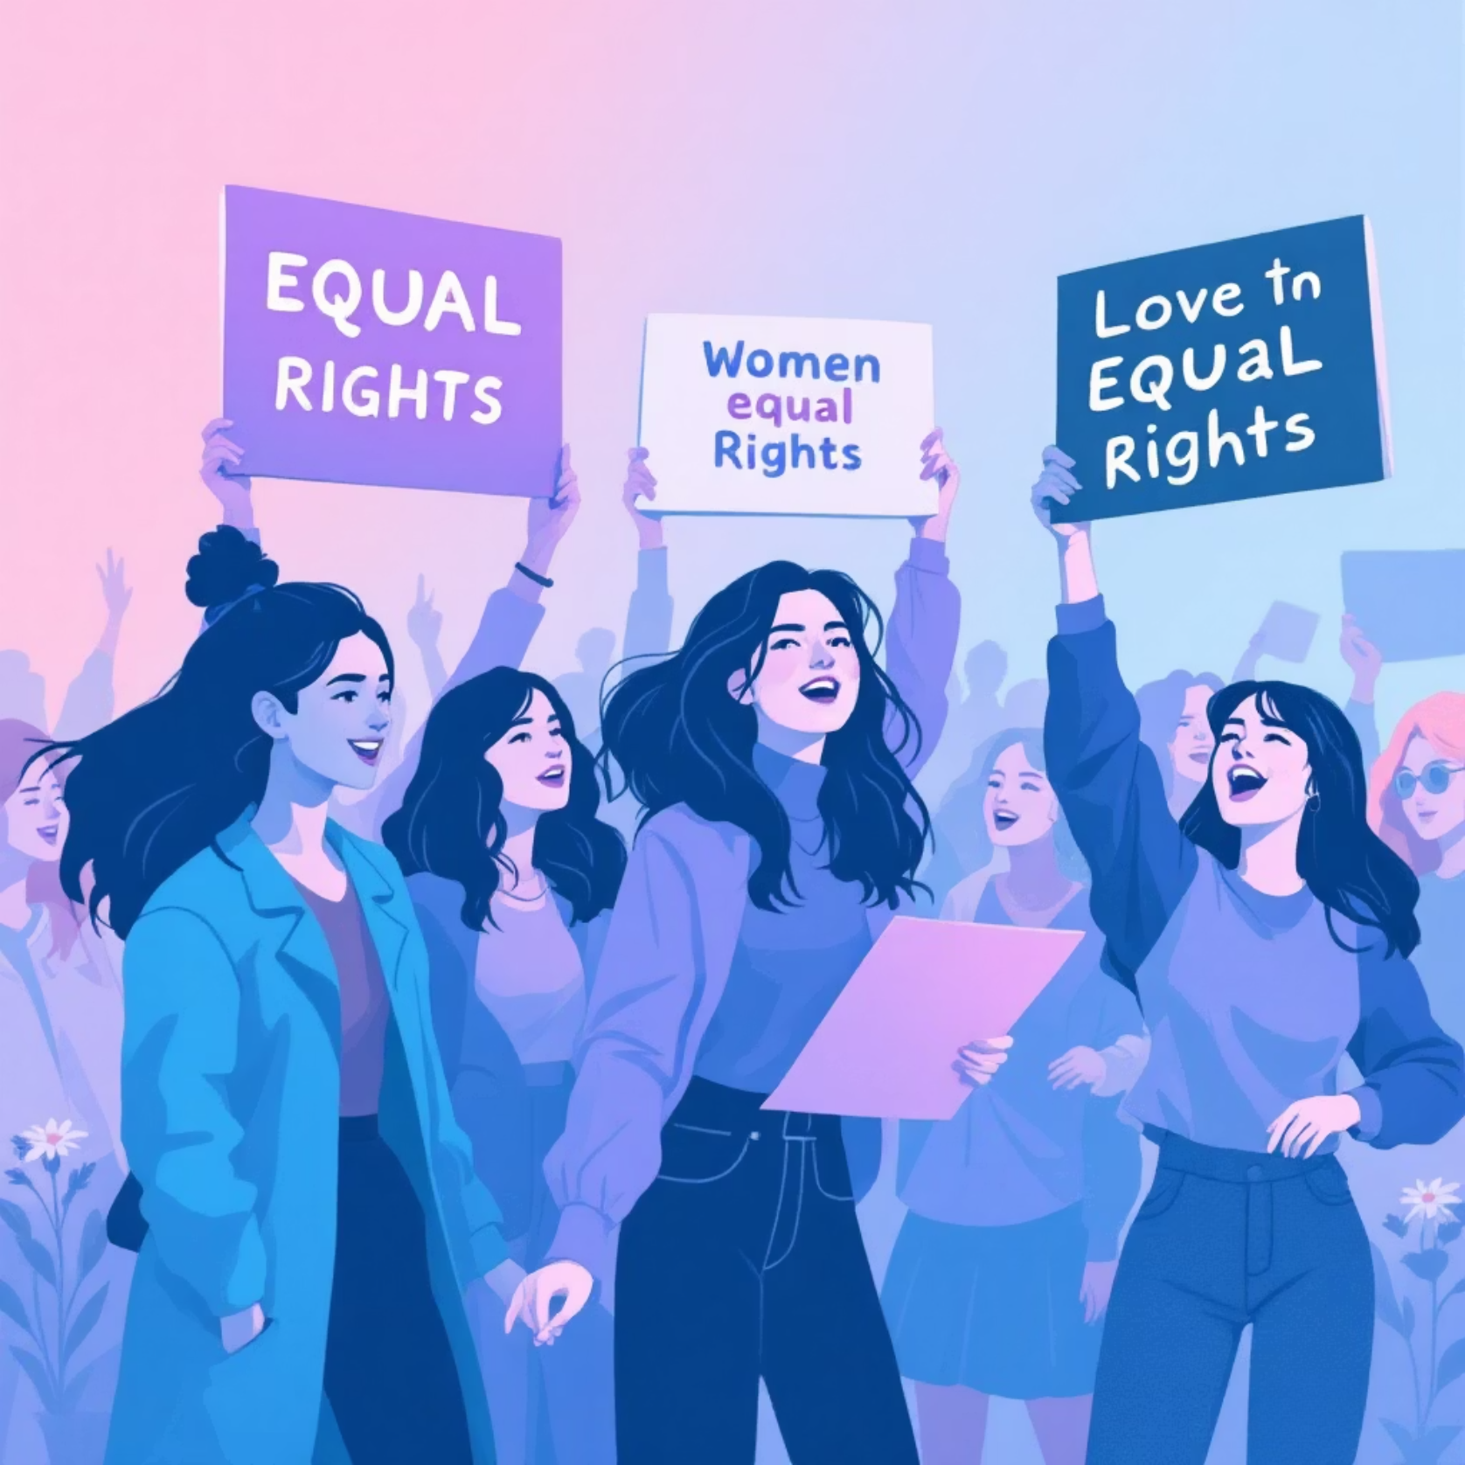
Patriarchy and the Rise of Feminist Movements
Patriarchy is a deeply entrenched social system where men, as a group, hold disproportionate power and authority over women. This dominance manifests across various aspects of society, including political leadership, economic control, legal frameworks, and social norms. In a patriarchal system, decision-making roles are often reserved for men, and women may face systemic discrimination and limited access to resources and opportunities.
Against this backdrop, feminist movements have emerged globally, including in India, to challenge these oppressive structures. These movements advocate passionately for equal rights for women in all spheres of life – education, employment, political participation, and family matters. Their efforts aim to dismantle discriminatory practices and achieve a society where gender is not a barrier to anyone's potential or dignity.
A landmark achievement in India's journey towards gender equality is the Equal Remuneration Act of 1976. This crucial legislation mandates that employers must pay equal wages to men and women for performing the same work or work of a similar nature, and prohibits discrimination in recruitment and working conditions. While legal frameworks like this are vital, continuous social awareness and enforcement are necessary to ensure their full implementation.

Slide 5



Persistent Challenges for Women in India
Despite progress, women in India continue to face significant challenges that hinder their full participation and equality. These issues are deeply rooted in societal norms and require sustained efforts to overcome:
Literacy Gap
Skewed Child Sex Ratio
Low Political Representation
A notable disparity persists in literacy rates. While male literacy stood at 76%, female literacy was significantly lower at 54% (as per 2025 projections). This gap impacts women's access to information, economic independence, and overall empowerment.
The child sex ratio (CSR) remains a grave concern, with only 914 girls born per 1000 boys. This alarming imbalance is primarily due to deeply rooted preferences for male children, often leading to sex-selective abortions, despite being illegal.
Women's participation in national and state politics is strikingly low. In the 2014 Lok Sabha elections, women constituted only 12% of elected members, and even less than 5% in state assemblies. This underrepresentation means their voices and perspectives are often marginalized in policy-making.
Recognising the critical need to boost women's political involvement, a significant measure has been the reservation of one-third of seats for women in local bodies (Panchayati Raj institutions and municipalities). This initiative has begun to empower women at the grassroots level, providing them with platforms to lead, advocate for community needs, and influence local governance directly.

Slide 6
Religion and Politics: The Dynamics of Communalism
India is a land of profound religious diversity, home to Hindus, Muslims, Sikhs, Christians, Buddhists, Jains, and many other faiths. This diversity is often celebrated, but the political expression of religious identity can also lead to complex challenges, particularly the phenomenon of communalism.
Communalism refers to the ideology that promotes religious identity as the primary basis for social and political action, often leading to antagonism and conflict between different religious groups. It is the belief that people belonging to the same religion share common secular interests, and that people of different religions have different, conflicting interests.
Communalism can manifest in various dangerous forms:
Religious Prejudices
Majoritarian Dominance
Everyday stereotypes and beliefs that one religion is superior to others, fostering mistrust and discrimination.
When the majority religious group seeks to assert its dominance over minorities, often leading to suppression of their rights and voices.
Political Mobilization
Communal Violence
Using religious symbols, leaders, and emotional appeals to rally support for political parties, often at the expense of national unity.
The most extreme form, involving riots, targeted attacks, and widespread destruction, often fueled by hate speech and misinformation.
A stark historical example is the widespread communal riots that accompanied the Partition of India in 1947, which resulted in immense loss of life and displacement. Even post-independence, India has witnessed occasional outbreaks of communal violence, highlighting the persistent need for secular values and harmony.

Slide 7
Caste and Its Enduring Political Impact
The caste system is a traditional social hierarchy that has deeply influenced Indian society for centuries. It divides people into hereditary groups, determining their social status, occupation, and even personal interactions. Despite being legally abolished, the effects of caste discrimination continue to be felt, especially in rural areas.
1
2
3
Persistent Discrimination
Economic Inequality
Impact on Life Opportunities
While untouchability is banned by the Constitution, its practice, particularly against Dalits (formerly "untouchables") and Adivasis (tribal communities), sadly persists in many subtle and overt forms, affecting access to water, public places, and social acceptance.
Caste strongly correlates with economic well-being. Historically, upper castes have enjoyed greater privilege and wealth, while Dalits and Adivasis often face systemic barriers that lead to higher rates of poverty, landlessness, and lack of opportunities.
Caste can significantly influence critical life aspects such as marriage choices, access to quality education, and employment opportunities. Inter-caste marriages still face social stigma, and discrimination can affect educational enrollment and job prospects, perpetuating cycles of disadvantage.
In politics, caste identity is a powerful mobiliser. Political parties often strategise by appealing to specific caste groups, forming alliances, and nominating candidates based on their caste affiliations to secure vote banks. This can sometimes lead to caste-based polarisation, but it has also, in some cases, provided a platform for historically marginalised groups to assert their political rights and gain representation.

Slide 8
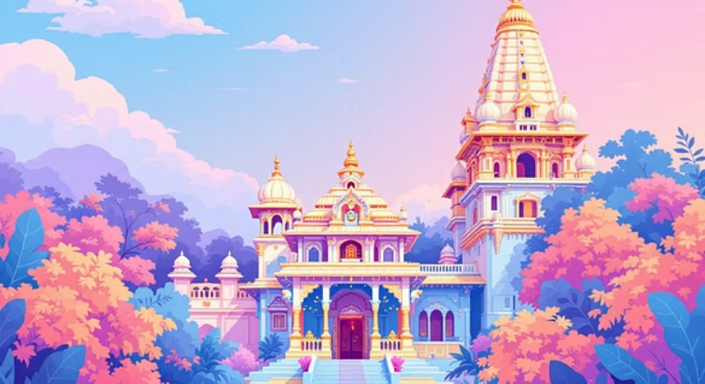
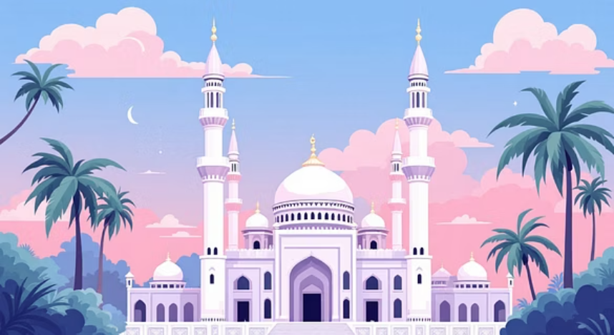
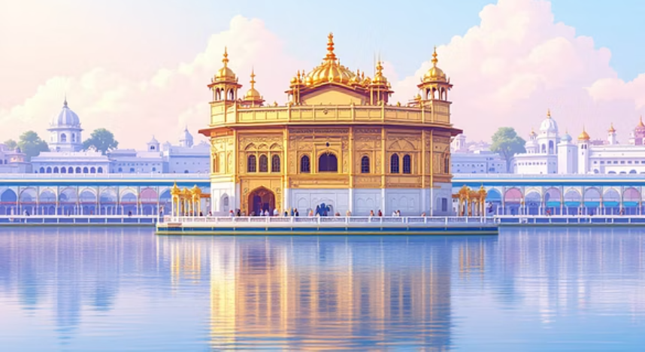
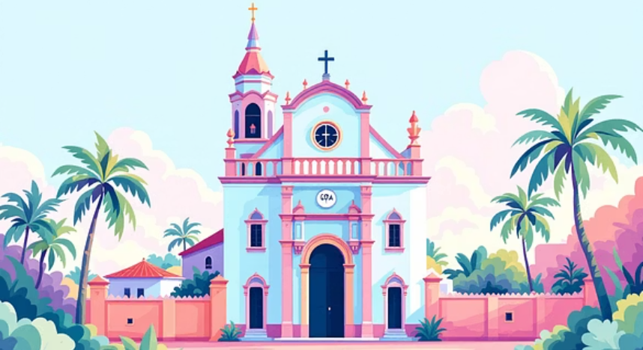


India's Vibrant Social and Religious Diversity
India is celebrated globally for its unparalleled social and religious diversity. It is a nation where multiple religions, countless castes, myriad languages, and distinct cultures coexist, creating a mosaic of traditions, beliefs, and ways of life.
India's democratic framework provides a unique space for the expression of these differences. Citizens have the freedom to practice their religion, celebrate their culture, and uphold their caste identities. However, this very freedom also presents inherent challenges. While diversity is a source of strength, it can also be exploited, leading to social friction and discrimination when identities are politicised for narrow gains.
In the political arena, this diversity is often a double-edged sword. Political parties frequently appeal to caste and religious identities to consolidate their voter base. They may form caste-based alliances, or use religious rhetoric to garner support. While this can sometimes empower certain communities by bringing their issues to the forefront, it also carries the risk of exacerbating divisions and undermining the secular fabric of the nation.
Understanding this intricate interplay between diversity and politics is essential for fostering an inclusive and harmonious society.

Slide 9



The Imperative of Political Representation
Political representation is not merely about having faces that look like you in power; it is about ensuring that the diverse experiences, needs, and perspectives of all sections of society are heard, understood, and addressed in the decision-making process. For women and other marginalized groups, gaining political power is absolutely crucial to tackling the systemic issues they face.
Voice for the Voiceless
Empowering Local Governance
Shaping Progressive Policies
A more inclusive political body is more likely to enact laws and policies that actively promote equality, social justice, and human rights for all citizens. This includes legislation on equal pay, protection against discrimination, access to education, and healthcare tailored to diverse needs.
When women and marginalized communities are represented, their unique challenges—such as gender-based violence, caste discrimination, or economic disparities—can be brought to the legislative agenda and debated effectively.
The reservation of seats for women in Panchayati Raj Institutions (local self-governing bodies in rural areas) has been a transformative step. It has significantly increased women's participation, enabling them to lead development initiatives, manage local resources, and address community-specific issues firsthand. This directly impacts grassroots development.
Ultimately, greater representation leads to more equitable resource allocation, targeted development programs, and a society where policies are truly reflective of the aspirations and welfare of all its people, moving beyond mere rhetoric to tangible change.

Slide 10




Key Laws and Movements Championing Equality
India has made significant legislative and social strides in its pursuit of equality and justice, addressing the historical disparities based on gender, religion, and caste. These efforts reflect a commitment to uphold constitutional values and ensure dignity for all citizens.
Equal Remuneration Act (1976)
Anti-Untouchability & Caste Discrimination Laws
This foundational law ensures that men and women receive equal pay for equal work or work of similar nature, and prohibits gender-based discrimination in hiring and employment conditions. It’s a vital step towards economic gender equality.
The Constitution of India abolished untouchability, and subsequent laws like the Protection of Civil Rights Act, 1955, and the Scheduled Castes and the Scheduled Tribes (Prevention of Atrocities) Act, 1989, aim to prevent and punish caste-based discrimination, ensuring social justice for marginalized communities.
Women's Movements
Promoting Secularism & Countering Communalism
Vibrant women's movements across India have been instrumental in pushing for critical reforms. They advocate for better access to education, enhanced safety measures against violence, increased political participation, and an end to discriminatory social practices like dowry and child marriage.
Ongoing efforts focus on strengthening India’s secular fabric, which espouses equal respect for all religions and non-discrimination by the state. This involves promoting inter-faith harmony, countering hate speech, and ensuring that religious identities do not become sources of political division or conflict.
These laws and movements collectively strive to build a society where opportunities are accessible to all, and every individual can live with dignity, irrespective of their gender, religion, or caste background.

Slide 11










Conclusion: Building an Inclusive India
Understanding the intricate dynamics of gender, religion, and caste is not merely an academic exercise; it is a crucial step towards actively fighting the deep-seated inequalities that still exist in our society. By acknowledging how these social constructs impact lives, we can better identify the challenges and work towards meaningful change.
Challenge Stereotypes
Identify Issues
Question outdated beliefs and biases.
Recognize the subtle and overt forms of discrimination.
Advocate for Rights
Speak up against injustice and inequality.
Support Inclusivity
Ensure all voices are heard and valued.
Promote Harmony
Foster understanding across diverse groups.
A vibrant democracy truly thrives when every voice is not only heard but also respected, and every citizen has an equal opportunity to contribute to national progress. The journey towards a fairer, more just society is a collective responsibility.
Each one of us, as students and future leaders, has a vital role to play. By challenging stereotypes, actively promoting empathy, and supporting equal rights for all, we can contribute to building an India that truly embodies its constitutional ideals of liberty, equality, fraternity, and justice for every single individual.

